Slide 1
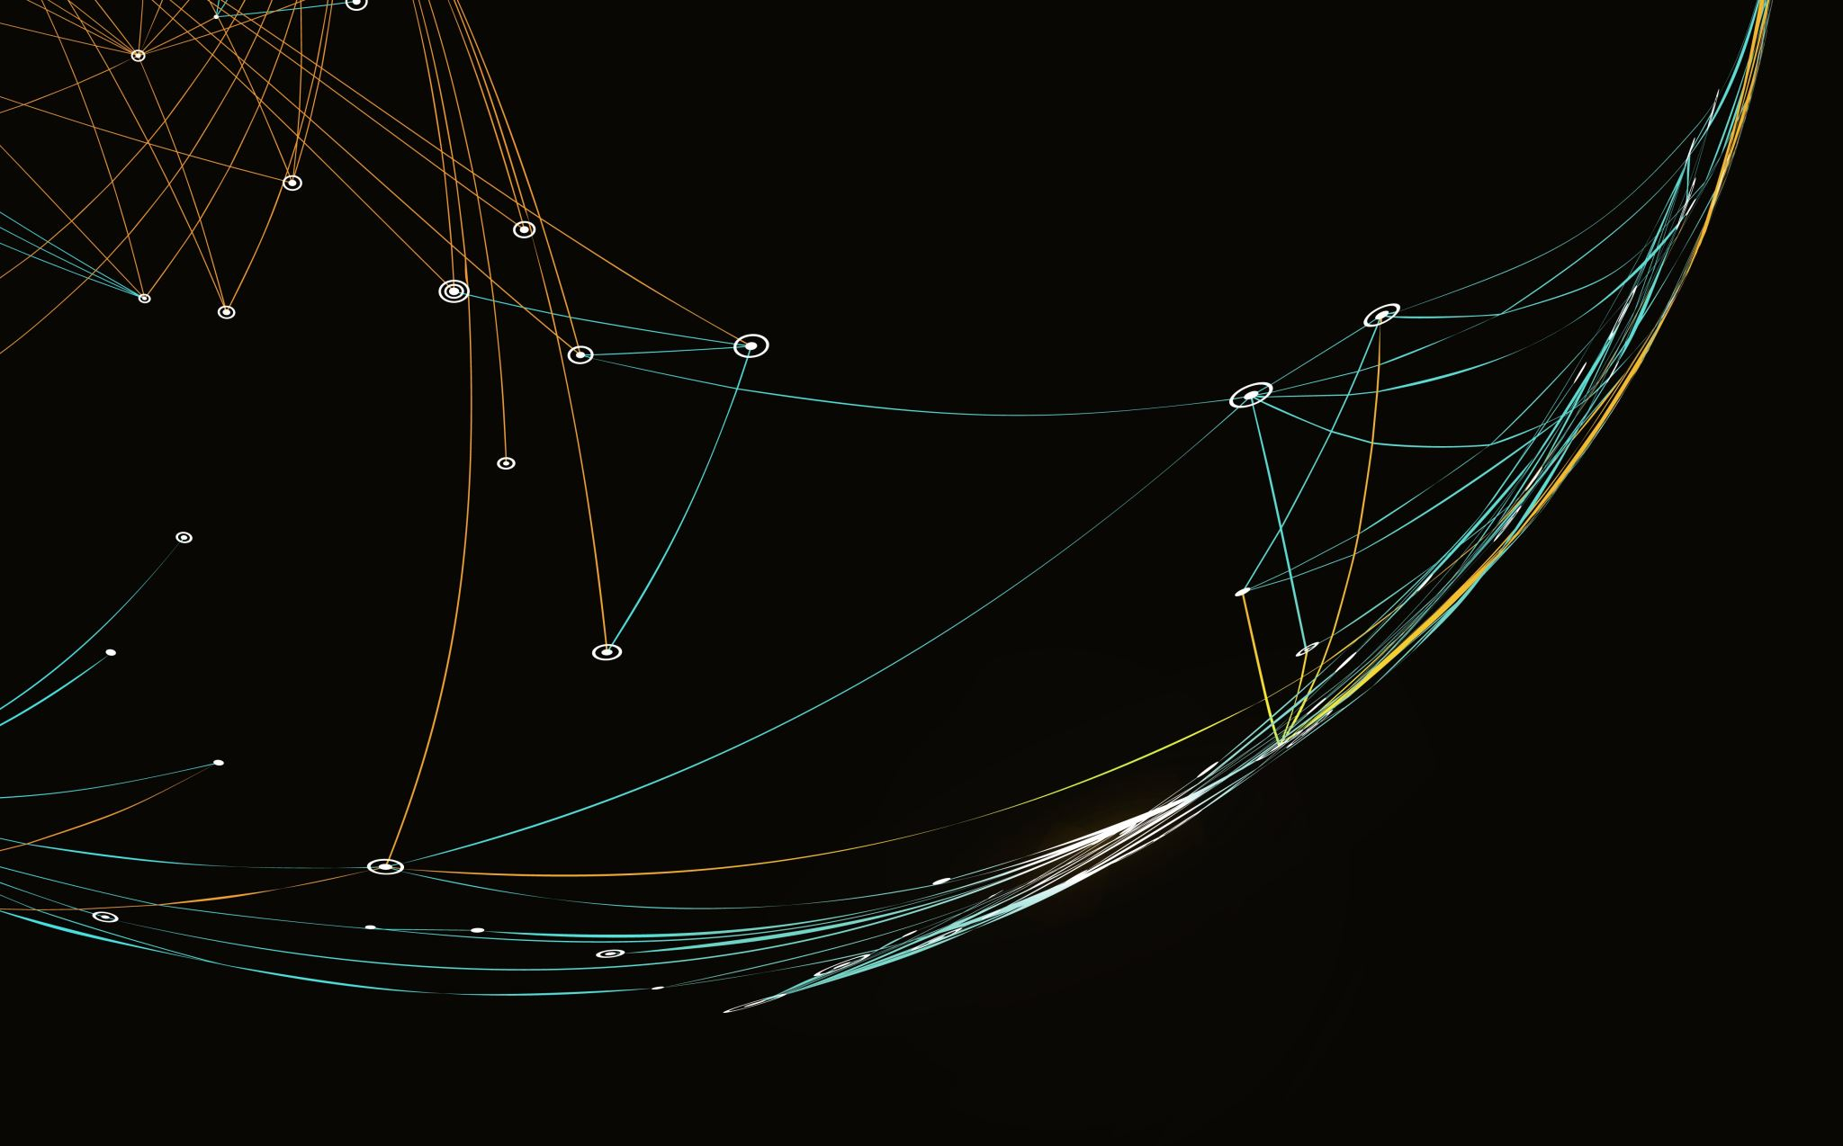
What is gRPC
Presented by Bobu Putheeckal
Notes:
Good Morning, Today I am going to make a DEMO on gRPC.
The presentation is going to be only few mins, followed by a demo for about 10 mins
I will also do a code walk through may be like 5 mins. Followed by Q/A
SO lets do this

Slide 2

Is it really fast?
TLDR- its really fast
Sometimes 4x times faster than REST
Notes:
Before getting to more details, I want to let you know the main reason I am talking to you about this is because, its really fast. I will try to convince you why we need to seriously give a look into this protocol

Slide 3

How Services communicate?
REST on HTTP 1.1
gRPC
HTTP 2.0
Messaging
AMQP
MQTT
Service Mesh
Notes:
Microservices communicate with each other using various communication patterns and protocols, depending on the specific needs of the application.
Here are some common patterns and protocols used for microservices communication:
HTTP/REST: Microservices can use HTTP/REST to communicate over the network.
Each microservice exposes a RESTful API that other microservices can call using HTTP requests.
This is a simple and flexible approach that can work well for many applications.
gRPC: Microservices can use gRPC to communicate using Remote Procedure Calls (RPCs).
gRPC uses protocol buffers as the serialization format and supports bidirectional streaming, flow control, and other features that make it a powerful tool for building microservices.
Messaging: Microservices can use messaging protocols like AMQP (Advanced Message Queuing Protocol) or MQTT (Message Queuing Telemetry Transport) to communicate asynchronously.
In this approach, messages are sent and received through a message broker or a message queue, which allows for decoupled communication between microservices.
Service Mesh: A service mesh is a dedicated infrastructure layer that manages communication between microservices.
It typically consists of a set of sidecar proxies that intercept and manage traffic between microservices.
The proxies can handle tasks like load balancing, service discovery, and traffic management, which can simplify the communication between microservices.

Slide 4
REST vs gRPC
REST – architectural style
gRPC is a Protocol
REST uses HTTP 1.1
gRPC uses HTTP 2.0
Notes:
REST (Representational State Transfer) is a style of software architecture that defines a set of constraints to be used when creating web services. RESTful web services are built around resources, which are identified by URIs. Clients can interact with these resources using standard HTTP methods, such as GET, POST, PUT, and DELETE. REST is often used for building scalable and modular web applications.
gRPC (gRPC Remote Procedure Call) is a modern high-performance RPC framework that was developed by Google. It uses protocol buffers, a language- and platform-neutral serialization format, to define its service contracts. gRPC supports multiple programming languages and platforms, making it a great choice for building microservices and distributed systems

Slide 5
HTTP 1.1 vs 2.0
Multiplexing
Binary Format
Header Compression
Server Push
Notes:
Multiplexing: One of the biggest differences between HTTP/1.1 and HTTP/2 is that HTTP/2 supports multiplexing, which allows multiple requests to be sent and received over a single connection.
This means that instead of opening multiple connections between a client and a server, HTTP/2 can use a single connection to handle all requests and responses, which can significantly improve performance.
Binary format: HTTP/2 uses a binary format instead of the text-based format used by HTTP/1.1. This makes it more efficient and easier to parse, which can also improve performance.
Header compression: HTTP/2 uses header compression to reduce the amount of data that needs to be sent over the network. This can also improve performance, especially on slow or congested networks.
Server push: HTTP/2 supports server push, which allows a server to send multiple responses to a single request. This can be useful for sending additional resources that a client is likely to request, such as images or stylesheets.

Slide 6
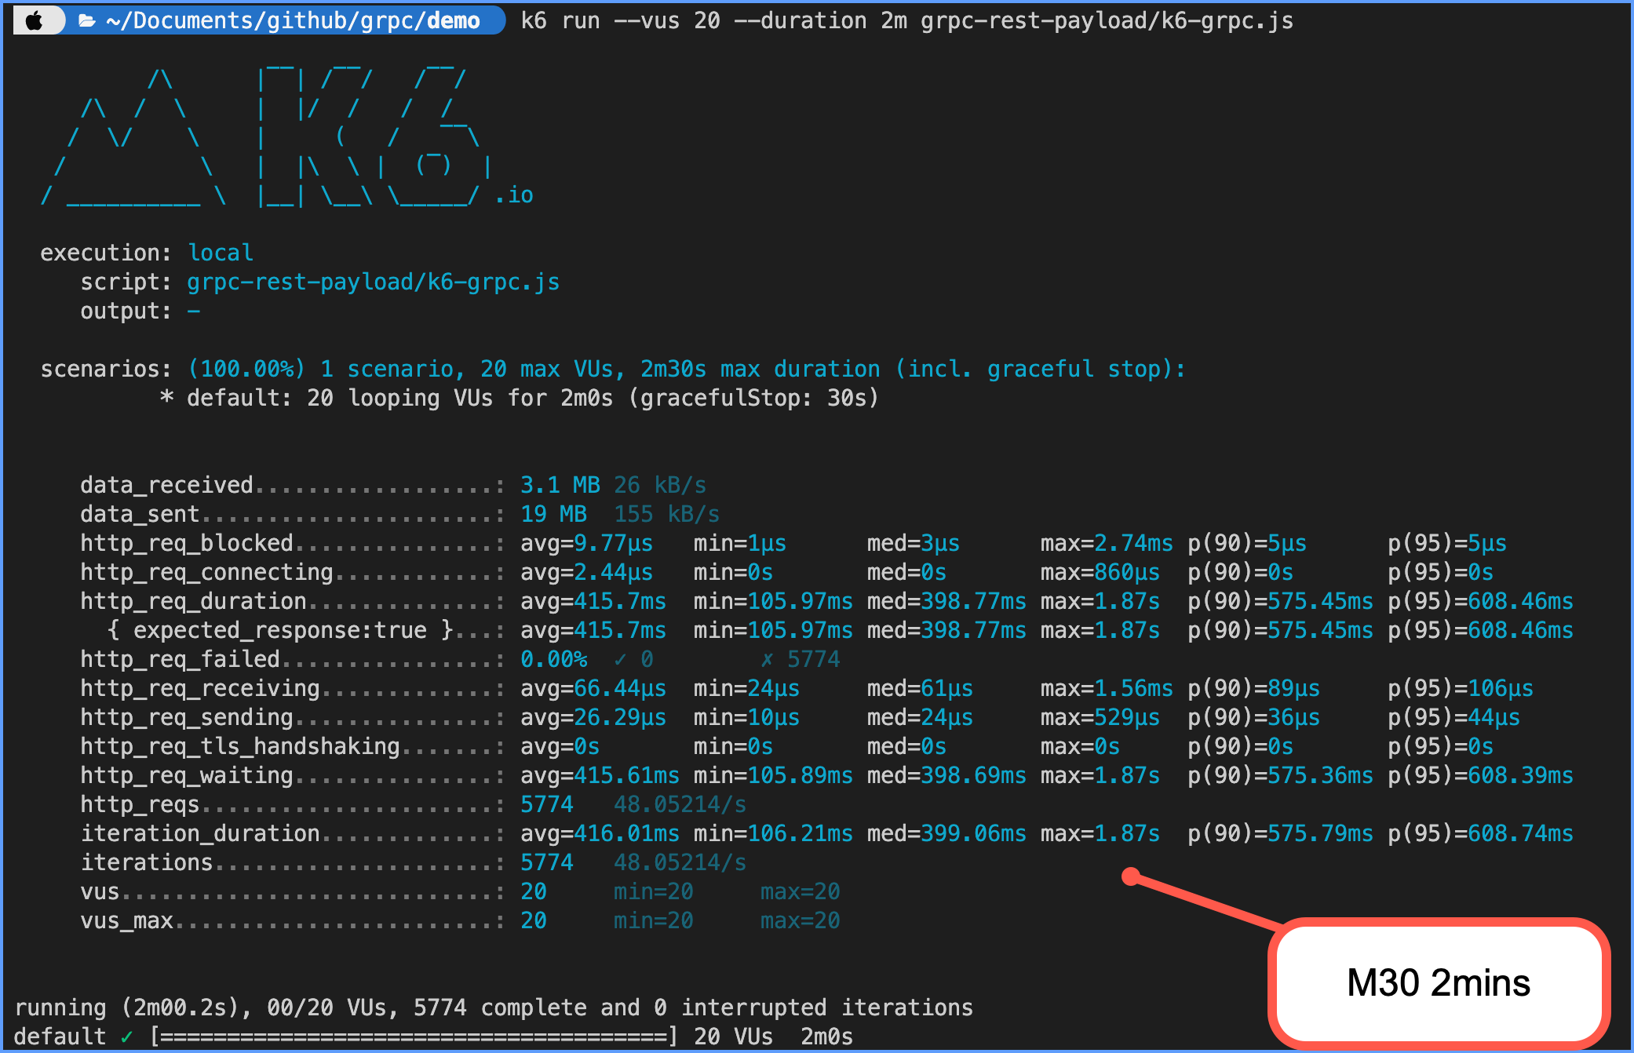
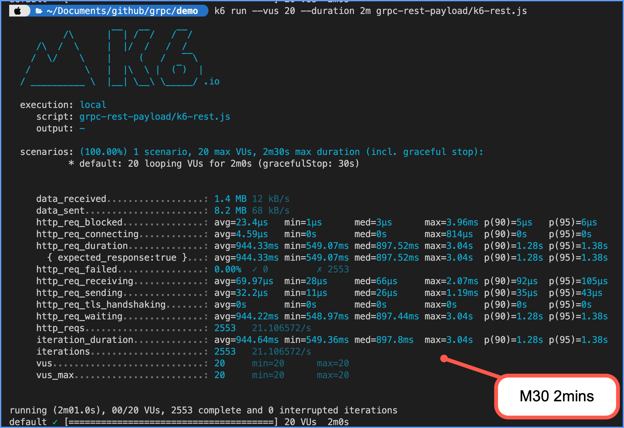
GRPC VS REST COMPARISON

Slide 7
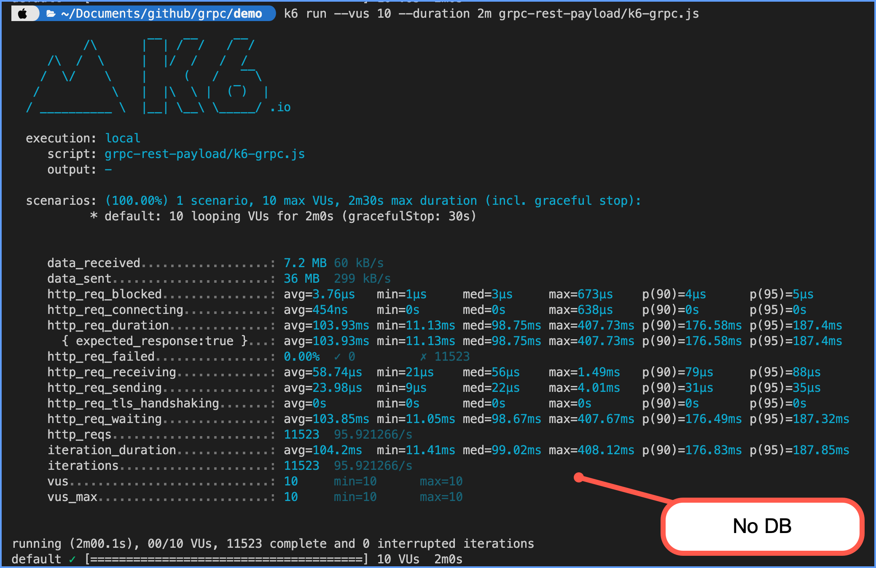
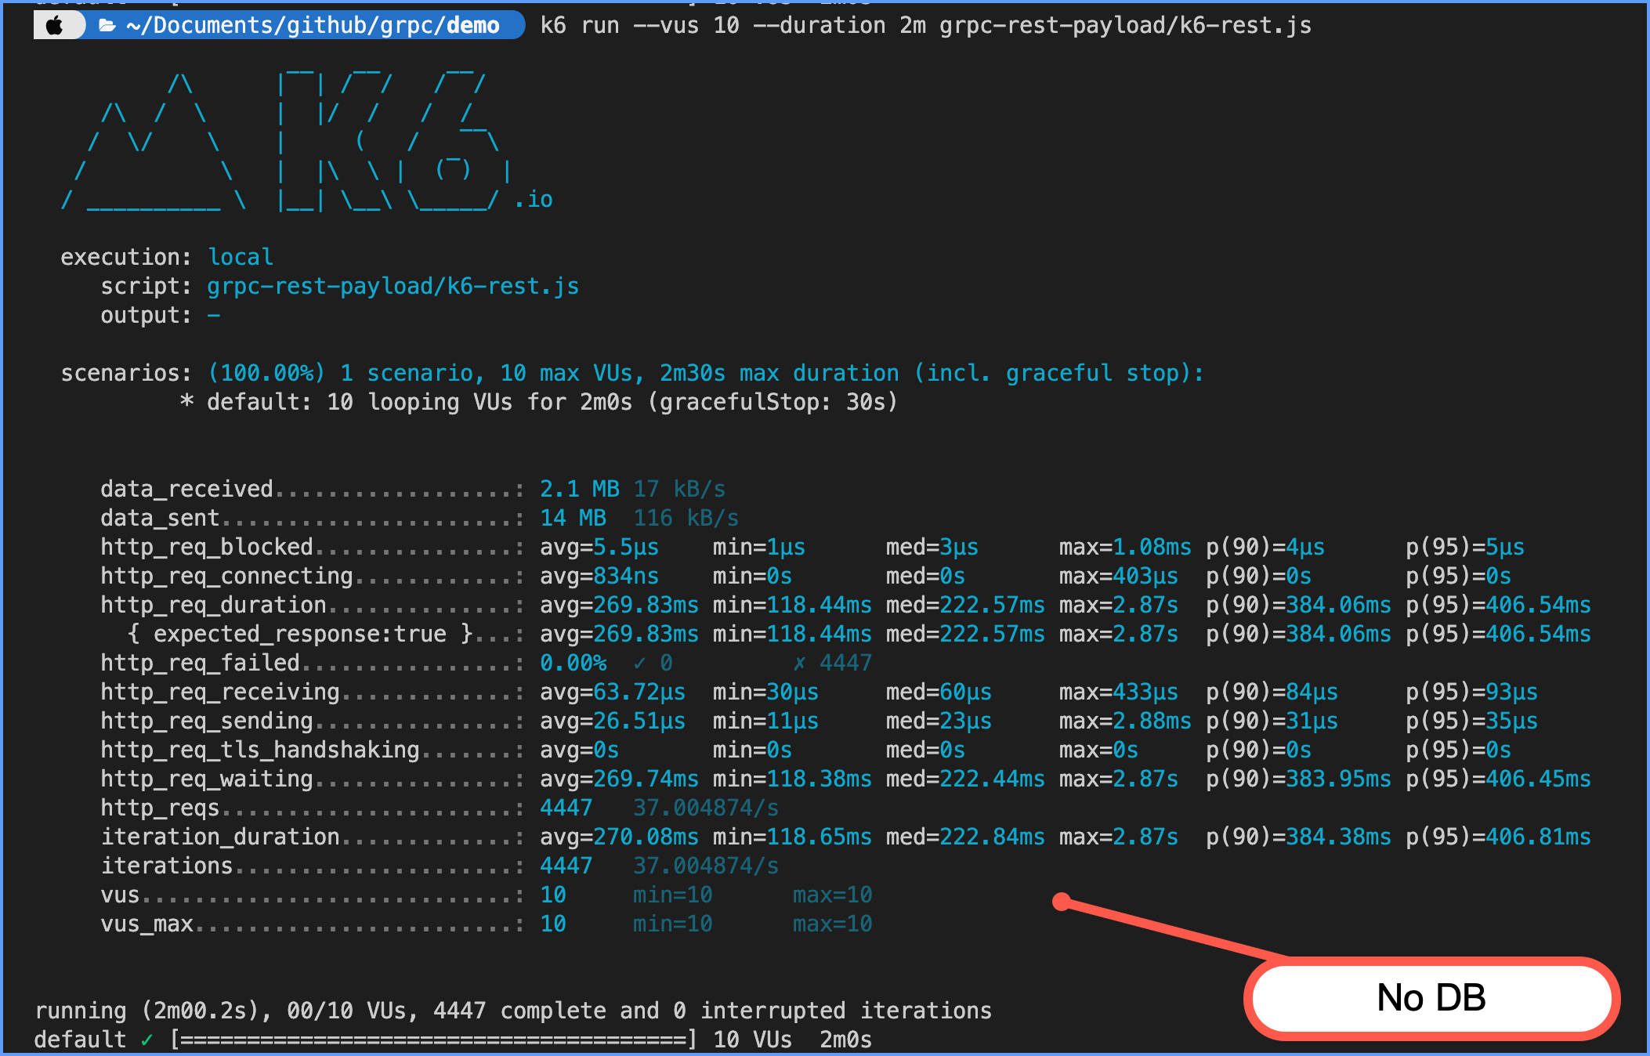
GRPC VS REST COMPARISON

